Slide 1
Linux Kernel Capability
Kickoff Meeting on 10-11-2017

Slide 2
Project Details
Project Type: | Capability
Project Classification: | Development
Client Details: | NA
Customer Representative: | NA
Engagement Model: | NA

Slide 3
Scope and Objectives
Scope includes development of modules for the Linux OS kernel, device drivers, applications for the Linux Embedded platform Modules from ongoing customer and internal solution project will be assigned
Objectives are as follows Gain hand-on on Linux kernel basic programing including Device Driver for various peripherals, functional testing, debugging. Understanding GES work flow process Gain understanding of GES project tools such as svn, static analyzer, bug tracker tools etc At the end of completion of this capability project engineer must be able to implement device driver and kernel module on Linux and be able to clear customer interviews for Linux based driver requirements

Slide 4
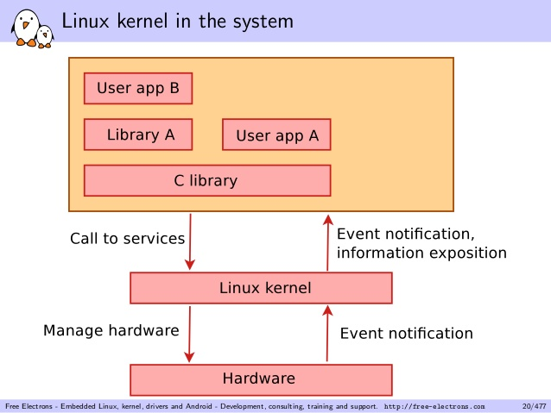
Overview and Architecture or System Diagram

Slide 5
Team ,Roles & Responsibilities and intergroup coordination, Skills and Gaps
SL. No | Name | Role | Responsibility | Skills | Gaps
1 | Abhijith | PM | Project Management |  | NA
2 | Mahesh K | STL | Technical | C, Linux Drivers | NA
3 | C M Naveen Kumar Reddy | SE | Development, Testing | C, Linux Fundamentals | Linux Drivers and various OS components.
4 | Tatikonda Venkata Rao | SE | Development, Testing | C, Linux Fundamentals | Linux Drivers and various OS components.
5 | Kalasariya Ravidra Jivanbhai | SE | Development, Testing | C, Linux Fundamentals | Linux Driver and various components.
6 | Saurabh Kumar | SSE | Development, Testing | C, Linux Fundamentals | Linux Driver and various components.

Slide 6
Team ,Roles & Responsibilities and intergroup coordination, Skills and Gaps
SL. No | Name | Role | Responsibility | Skills | Gaps
7 | Pankaj Kumar | SE | Development, Testing | C, Linux Fundamentals | Linux Driver and various components.
8 | Kalva Prasanna Kumar | SE | Development, Testing | C, Linux Fundamentals | Linux Driver and various components.
9 | G Sarathbabu Naidu | SE | Development, Testing | C, Linux Fundamentals | Linux Driver and various components.
10 | Dakshiraju Naresh | SE | Development, Testing | C, Linux Fundamentals | Linux Driver and various components.
11 | Rajendra D | QA | SQA coordinator | C, Linux Fundamentals | Linux Driver and various components.

Slide 7
Estimation Details
Estimated Effort | 2.5 Months
Estimated Size | 8
Estimated Schedule in calendar months | 2.5 Months
Expected Start Date | 10-Nov-17
Expected Completion Date | 18-Jan-18

Slide 8
Milestones
Sl.No | Milestone | Target Date
1 | ARM presentations | 14-11-17
2 | Linux Driver basic presentation | 16-11-17
3 | Environment setup and various boot options like tftp, nfs, mmc, uart, cross compilation. | 20-11-17
4 | Linux pseudo code Character driver and app ,unit and functional testing | 27-11-17
5 | Linux pseudo code block driver and app ,unit and functional testing | 5-12-17
6 | Kgdb | 13-12-17
7 | Kernel mem leak and profiling tools, static analyzer tools. | 21-12-17
8 | Actual drivers | 18-01-18

Slide 9
Resource requirement
 |  |  |  | Required Duration
Department |  |  | Current Availability /Req | Start date/Target date | End date
System Admin | Hardware Requirement
 | 1 | Beaglebone /RPI | yes | 10-11-17 | 18-01-18
 | 2
 | Software Requirement
 | 1 | Linux source | yes | 10-11-17 | 18-01-18
 | 2
 | Access permission
 | 1 | SVN (need to create) | No | 10-11-17 | 18-01-18
 | 2 | Gitlab(need to create) | No | 10-11-17 | 18-01-18

Slide 10
Resource requirement
 |  |  |  | Required Duration
HR | Resource Requirement
 | 1 | SSE | 1 | 10-11-17 | 18-01-18
 | 2 | SE | 7 | 10-11-17 | 18-01-18
 | 3 | TE |  |  | 18-01-18
 | 4 | PL/STL | 1 | 10-11-17 | 18-01-18
Quality | 1 | Audit requirements | 1 | 10-11-17 | 18-01-18
 | 2 | Standards |  | 10-11-17 | 18-01-18
 | 3 | Tailoring, Deviation |  | 10-11-17 | 18-01-18

Slide 11
Resource requirement
Administration | 1 | Statutory Compliances for items received
 | 2 | Security of supplied hardware
Training | 1 | Technical Training Requirements | C, ARM, Device Drivers, Debugging Techniques | on job training
 | 2 | Tools Training Requirements | SVN, GIT, Hardware handling
 | 3 | Process Training Requirements | GES Project Workflow , IP Security

Slide 12
Project Management Expectations
Deliverables
Source Codes, Bring up guides, Test results
Documents
Project workbook, SPP, GES Sprint Sheet, HLD, LLD, Code, Test reports
Records
Meeting MOMs, Process Compliance check Forms, Weekly Status Reports, Management Approvals etc.,
SDLC Model
Agile
Project Monitoring and tracking
Sprint sheet
Project Progress Reviews
Weekly status report and monthly meeting
Timesheet maintained in Sprint sheet
Project Monitoring Records
Escalation – Responsibility
SE/SSE -> ML -> TL -> PL -> PM -> PH

Slide 13
Review Plan and Defect Prevention Plan
Review Plan
SPP Reviews, SQA Reviews
SRS review (requirements will be part of Sprint sheet)
HLD review
Code review
Test Case review
Responsibility for SQA Reviews, PM Reviews and Senior Management Reviews with Target date
Defect Prevention Plan
Refer to the Organization’s DP Database.

Slide 14
Initial Risks Identified (if any)
Risks Identified | Probability | Severity | Impact | Contingency/ Mitigation Plan
Availability of hardware | 0.5 | Medium | Schedule
Exposure to customer code base | 0.5 | High | IP | Need to ensure NDA and training on IP protection.

Slide 15
Key Success Factors and Best Practices adopted from Other Projects
Key Success Factors
Timely Communication And Escalation.
Efficient and Optimized Code
On Time Delivery
Best Practices adapted
Usage of Knowledge Repository
Tool usage such as SVN, Clang
Code Review – Review by peers at GES
Project Tracking using Software Project Plan
Weekly Status Reports
100% compliance with time sheet filing
QA Process- CMM Level 5/Level 3
Weekly Team Meetings

